Slide 1

Multi-Agent NLP-to-SQL Pipeline for Manufacturing Operations:
A Case Study on the Production Database
Team Members:
Wisdom Favour Chizoba
Thiruselvam Shreecharan
Project Progress Update
Guided by:
Prof. Dr.-Ing. Hamidreza Heidari

Slide 2
Introduction: Why NLP-to-SQL?
Manufacturing production, quality and traceability data require database knowledge to query reliably.
Research takeaway:
• Accurate SQL needs schema grounding and an understanding of factory terminology.
• Retrieval, few-shot prompts and execution feedback are relevant approaches—but must be tested.
Our current milestone:
• Planner, Coder and Critic agents built; evaluation against the test questions is underway.

Slide 3
Project Scope & Current Status
Aim
Use a three-agent NLP-to-SQL workflow to answer manufacturing-data questions through SQL.
Completed / team-reported
• Three agent roles built: Planner, Coder and Critic.
• Bibliography report reviews 11 Text-to-SQL research papers and their relevance.
In progress
• Test-set evaluation: SQL generation, execution outcomes, error types and response time.
Not claimed at this stage
• Final accuracy, production deployment or independently verified read-only enforcement.

Slide 4
Objectives & Progress
• BUILT — Planner, Coder and Critic agent components for natural-language-to-SQL processing.
• TESTING — Run benchmark questions and compare SQL/results with reviewed references.
• TO VALIDATE — SELECT-only checks, read-only privileges and correction behavior.
• REPORTED — Completed comparative bibliography review; numerical performance will follow testing.

Slide 5
Technology Stack & Status
Process | Tool / Framework | Current scope / status
Data source | MariaDB / Docker (proposal) | Authorized snapshot and schema: confirm before claims
Agent workflow | Planner / Coder / Critic | Three roles built; integration/testing ongoing
Language model | Claude / Anthropic API (proposed) | SQL generation interface; configuration to document
Safety | SQL validation + read-only user | Safeguards to verify during testing
Evaluation | Python + test questions | In progress: execution, correctness, latency, errors
Interface | Streamlit (proposed) | Demo UI; implementation status not yet independently verified

Slide 6
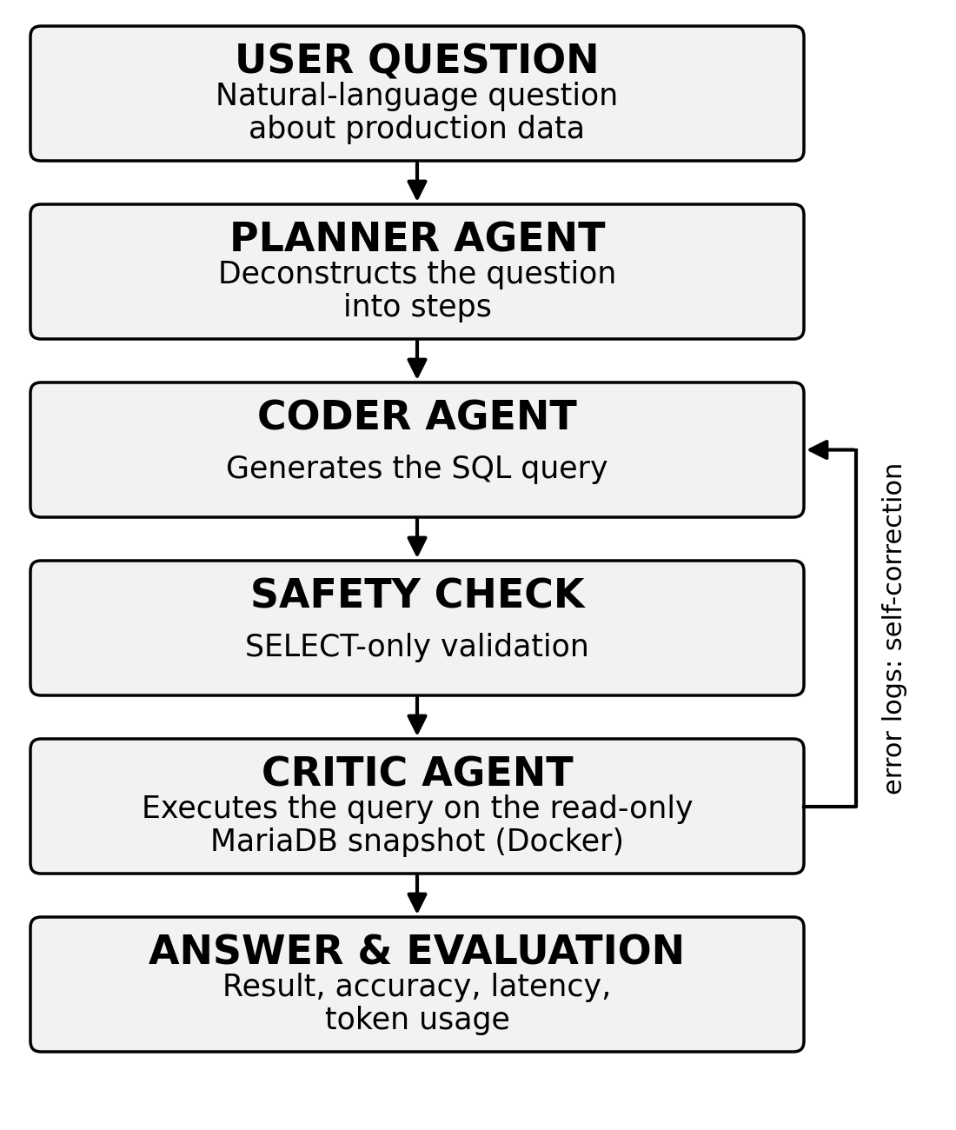
Three-Agent Workflow (Prototype)
CURRENT STATUS
Planner, Coder and Critic: built
Question-set testing: underway
Validator and permission checks: to verify
No final benchmark accuracy reported yet.

Slide 7
Working Methodology: Progress
Step 1: Literature & Method Outline — COMPLETED
Comparative review of 11 papers; proposed architecture and evaluation criteria defined.
Step 2: Three-Agent Development — BUILT
Planner, Coder and Critic components implemented (team-reported status).
Step 3: Test Questions — IN PROGRESS
Run questions; inspect generated SQL, reference answers, execution errors and latency.
Step 4: Validation & Results — NEXT
Check safety controls and analyze outcomes before reporting measured accuracy.

Slide 8
What We Have Done So Far
Workstream | Scope | Status | Evidence / next step
Three agents | Planner, Coder, Critic | Built | Test handoffs and returned SQL
Literature review | 11 published papers | Draft ready | Main report for submission
Evaluation | Reference questions | Testing | Record accuracy and errors; no final score

Slide 9
Evaluation: Targets
Our one-page proposal defines these targets:
• ~85% of generated SQL queries execute without syntax errors.
• ~75% semantic match with reference SQL.
• Average query generation time below five seconds.
• Estimated 80% reduction in time-to-insight (to be measured).
Current state: testing underway; no confirmed project performance figures yet.

Slide 10
Safety & Ethics: Checks to Confirm
• Validate SELECT-only SQL handling and restricted database permissions.
• Use only authorized, anonymized production data; confirm data-owner approval.
• Review what schema details or sample values may be sent to a hosted API.
• Record test traces and errors without exposing sensitive production records.
• Keep synthetic baseline results separate from actual MariaDB/Claude results.

Slide 11
Next Steps
Finish testing the three-agent pipeline on the agreed question set.
• Record generated SQL, result correctness, failures, response time and retry behavior.
• Verify SQL validation and read-only access before any sensitive-data execution.
• Compare agentic behavior with a simple single-call baseline under the same conditions.
• Incorporate verified findings into the next methodology and final project report.

Slide 12
Selected Literature (Full Review: 11 Papers)
• Zhang et al. (2023) — ReFSQL: Retrieval-Augmentation Framework (EMNLP).
• Gao et al. (2024) — Text-to-SQL Empowered by LLMs (PVLDB).
• Mao et al. (2024) — DART-SQL: Rewriting and Execution Feedback (ACL).
• Wang et al. (2025) — MAC-SQL: Multi-Agent Framework (COLING).
• Chen et al. (2025) — ADEPT-SQL: Enterprise Databases (ACL).
• Lemos et al. (2026) — An Industrial Database Interface (ECAI proceedings).
Complete 11-paper analyses, comparisons and references: separate bibliography report.

Slide 13
Milestones — status on 3 November
 | (Oct)Week 43 | Week 44 | (Nov)Week 45 | Week 46 | Week 47 | Week 48 | Week 49 | (Dec)Week 50 | Week 51 | Week 52 | Week 53 | (Jan)Week 01 | Week 02
Proposal & bibliography
Three-agent development
Testing & SQL validation
Analysis & final report

Slide 14
Thank You
Three agents built • Question-set testing in progress
Primary submission: Group 8 bibliography report
Group 8 repository (original link)

